Slide 1
Издательские решения Oxford University Press для исследователей и библиотекарей
Marcin Dembowski– marcin.dembowski@oup.com
Minsk, NLB
March 2018

Slide 2

Agenda
Oxford University Press
Resources supporting studying, teaching and research
How to get published
Questions

Slide 3
Oxford University Press

Slide 4

The University of Oxford
Overview
The oldest university in the English speaking world.
It is a collegiate research based institution.
Notes:
The University is made up of a variety of institutions, including 38 constituent colleges and a full range of academic departments which are organised into four Divisions. All the colleges are self-governing institutions as part of the University, each controlling its own membership and with its own internal structure and activities.

Slide 5

Oxford University Press (OUP)
Our mission
Oxford University Press is a department of the University of Oxford. It furthers the University's objective of excellence in research, scholarship, and education by publishing worldwide.
John Fell
Clarendon Presentation—Tim Barton (November 2011)
Notes:
Emphasise we publish within the university’s mission: “Excellence in Research and Scholarship”.

Slide 6
How to use scientific products to support your research?

Slide 7

  The Information Overload Problem
  Difficult to keep up with developments in the field
  Labor-intensive to start research in unfamiliar areas
  Slows productivity on research projects
  Guiding students is major challenge.

Slide 8
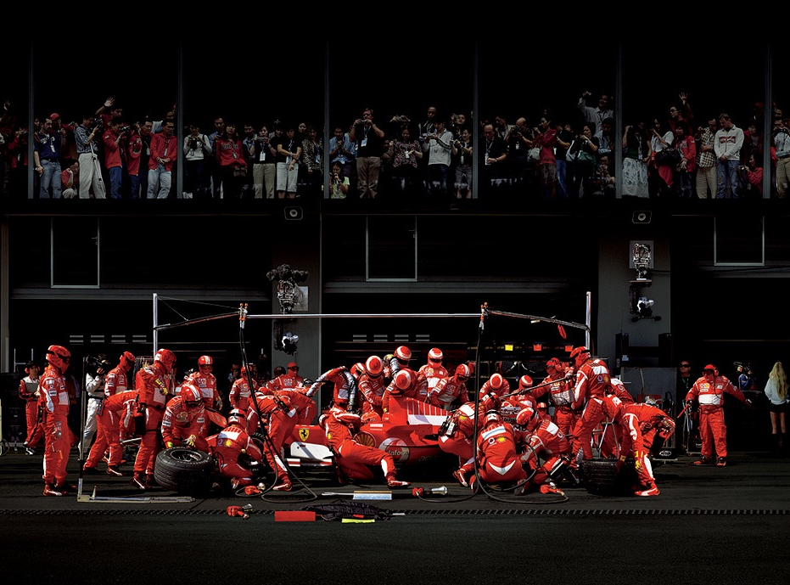
Mobilizing the community of experts

Slide 9

Global network of research

Slide 10








Each resource provides a vital step on the research journey, from quick fact checking, to reviewing the literature in a field, to keeping up to date with the latest research.
Where do OUP Resources Fit in your Research Journey?
Subject Specific Resources
Notes:
The following slides show how each resource fits into the research journey. Each resource provides a vital step on the research journey, from quick fact checking, to reviewing the literature in a field, to keeping up to date with the latest research.

Slide 11
Which resources from OUP I can access in NLB?

Slide 12
Oxford University Press Journals Collection

Slide 13
OUP’s Mission
What does it mean?
OUP publishes the highest-quality journals and delivers this research to the widest possible audience. We achieve this by working closely with our society partners, authors, and subscribers in order to provide them with publishing services that support their research needs

Slide 14









OUP and the Academic Community
Publishing Collaboratively
Over 70% of OUP’s Collection journals are published on behalf of societies and academic bodies, and this is increasing
Notes:
OUP publishes prestigious and authoritative journals in collaboration with some of the world’s most respected and influential scholarly and professional societies.
We are all part of the same research community.
Over 70% of OUP’s journals now belong to societies and academic bodies.
Societies and academic bodies include:
European Society of Cardiology
American Society for Clinical Pathologists
Organization of American Historians
European Society of Human Reproduction and Embryology
World Bank
Royal Astronomical Society
Infectious Diseases Society of America
American Academy of Religion
The Gerontological Society of America

Slide 15
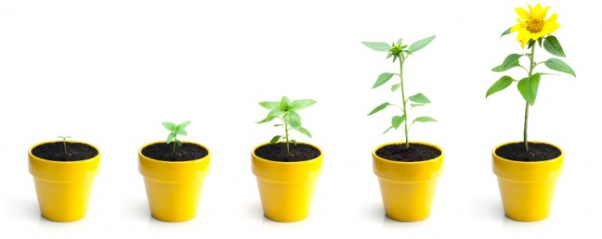
The 2018 Collection
339 titles
18 titles joining the Collection

Slide 16
Oxford Journals Collection
*Library Journal – New World, Same Model | Periodicals Price Survey 2017

Slide 17
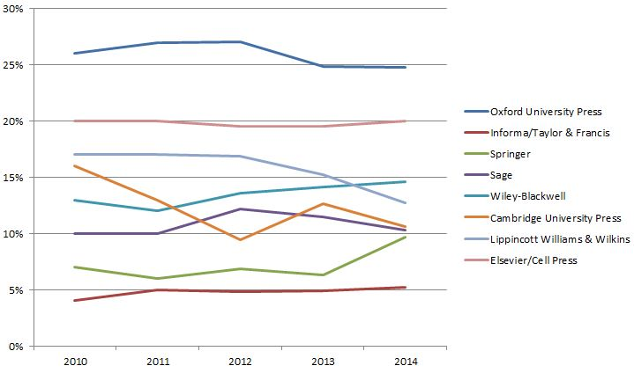
Commitment to Quality
Journals in the top 10% of their field
25% of OUP’s Journals rank in the top 10% in their subject area over 5 years.
17

Slide 18
Rankings in Best JCR Subject Category - 2018 Oxford Journals Collection
Source: 2016 Journal Citation Reports® (Clarivate Analytics, 2017)

Slide 19
Oxford Journals – Top Rankings
Of journals with a JCR entry…
23% are in the top 10% of their best category
51% are in the top 25%
81% are in the top 50%
#1 Journals in JCR Category:
Human Reproduction Update (Obstetrics & Gynecology | Reproductive Biology)
African Affairs (Area Studies)
Applied Linguistics (Linguistics)
Journal of Public Administration Research and Theory (Public Administration)
The Journals of Gerontology, Series A: Biological Sciences & Medical Sciences (Geriatrics & Gerontology)
Quarterly Journal of Economics (Economics)
Other high-ranking journals:
European Heart Journal #2 journal in Cardiac & Cardiovascular Systems with an Impact Factor of 19.651 – the highest Impact Factor amongst OUP Journals
Three journals of the European Society of Human Reproduction and Embryology (Human Reproduction, Human Reproduction Update, and MHR) are ranked 1, 2, and 4 in Reproductive Biology

Slide 20
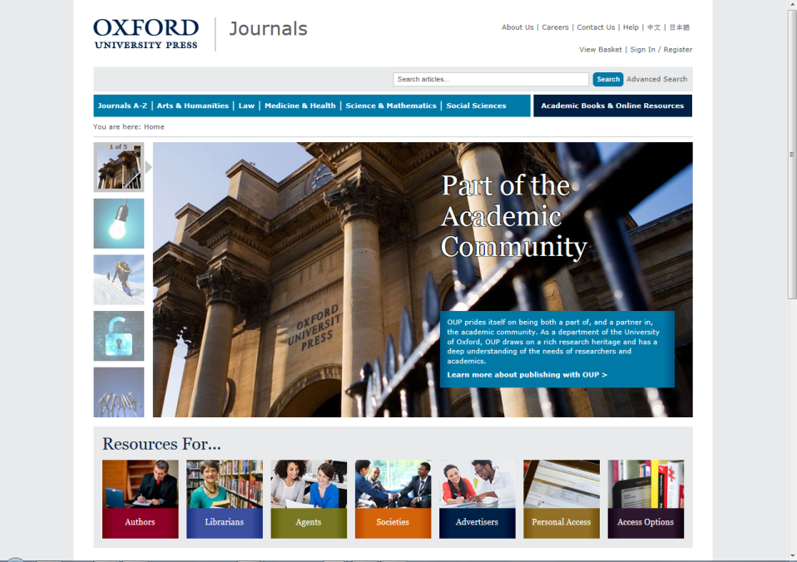
www.oxfordjournals.org

Slide 21
Current needs of universities?

Slide 22
Teaching
Research
Academic Publishing

Slide 23



Digital Reference at OUP
OUP’s digital reference programme addresses the need for contextual information at the beginning of a research project
It publishes three basic content types (or product families) that each provide a unique pathway into unfamiliar topics
Each content type summarizes primary research, but does so in a unique way to support a specific research need or user journey
Each features peer-reviewed, long-form, academic articles
Reading Guide: I need to know what the best sources are on a topic, and I’ll do my own reading of primary research
Overview: I need comprehensive overview with everything I need to know in a half-hour of reading or less
Reviews: I need a critical review of the current state of the scholarly debate on a topic

Slide 24

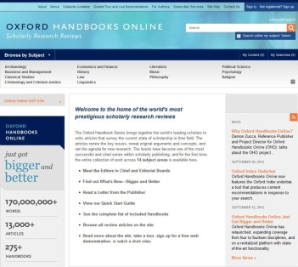
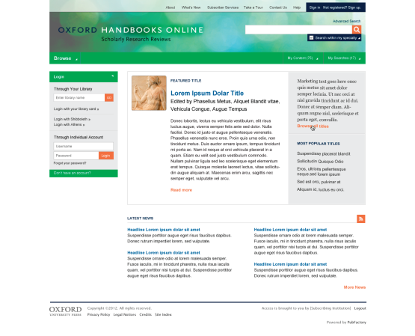



Online Editorial Process
Print Handbooks
• Handbook Commissioned
• Author submits chapter
• EIC and book board review
• Submit approved essay
• OUP publishes in OHO
• Revise and update for print
Oxford Handbooks Online
• Editor in Chief
• Ed Board of area specialists
• Recommend new topics/authors
• Recommend update
• Peer-review Board or external
• OUP publishes in OHO
Notes:
How will it work?
Print program, print approvals, exactly as they were in the past
Except that Ref DE acts as an intermediary routing chapters into production as they are submitted by HB editor
Can make changes before print work is complete
Online side we have commissioned EIC and Board in every field
They have a view of the full program –
all the chapters that have been published, where there are gaps and opportunities
Recommend topics for online-only and authors to write
Review those essays
Recommend when article may need update
Review essays that come in or recommend reviewer
Goal is to have a high-level, original review essay on all topics of interest in field
A highly discoverable site linked to our other publishing in the field
One-stop when you need a sophisticated take on the current state of debate and the future of that research

Slide 25
University Press Scholarship Online
Delivering the best scholarly publishing from leading university presses around the world
universitypressscholarship.com
Notes:
Title, strapline, URL

Slide 26






















University Press Scholarship Online
Participating Presses
Subject areas
Anthropology
Archaeology
Art
Architecture
Biology
Business and Management
Classical Studies
Computer Science
Earth Science & Geography
Economics and Finance
Education
Environmental Science
Film, Television, and Radio
History
Information Science
Law
Linguistics
Literature
Mathematics
Music
Neuroscience
Palliative Care
Philosophy
Physics
Psychology
Political Science
Public Health and Epidemiology
Religion
Society and Culture
Social Work
Sociology
Notes:
Subject coverage/content

Slide 27
Very Short Introductions

Slide 28
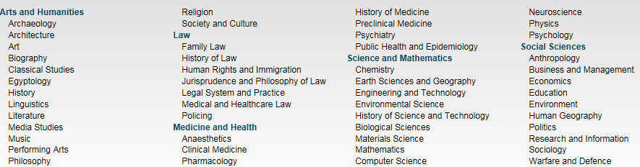
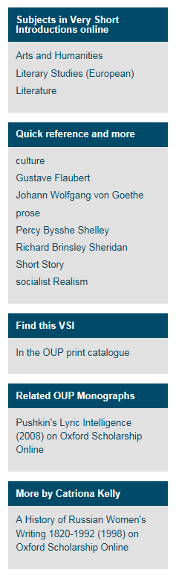
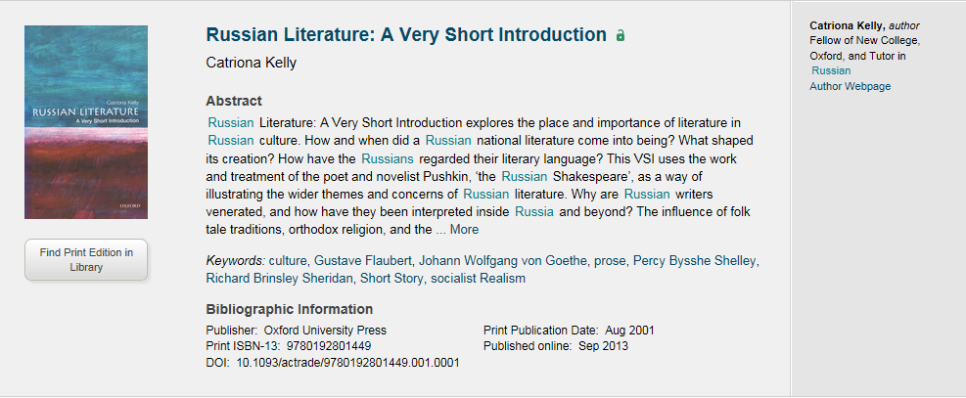
Very Short Introductions
VSI gives you an A-Z about any subject area with simple words to make the subject more approachable especially something like Quantum Physics.
Very Short Introductions offer concise introductions to a diverse range of subject areas
400+ books available
5 Subject Area with 50 different subtopics
Explore the content
The extra material (right of the slide) for every book – videos, blog posts, additional material from other resources (OSO and ORO), additional linking related to the topic or the author.
The author webpage and the ability to locate the physical book in one’s own library
Notes:
In the research journey, these fall within the references because it gives you an A-Z about any subject area with simple words to make the subject more approachable especially something like Quantum Physics.
Very Short Introductions offer concise introductions to a diverse range of subject areas
400+ books available
5 Subject Area with 50 different subtopics
Things to highlight –
The extra material (right of the slide) for every book – videos, blog posts, additional material from other resources (OSO and ORO), additional linking related to the topic or the author.
The author webpage and the ability to locate the physical book in one’s own library

Slide 29
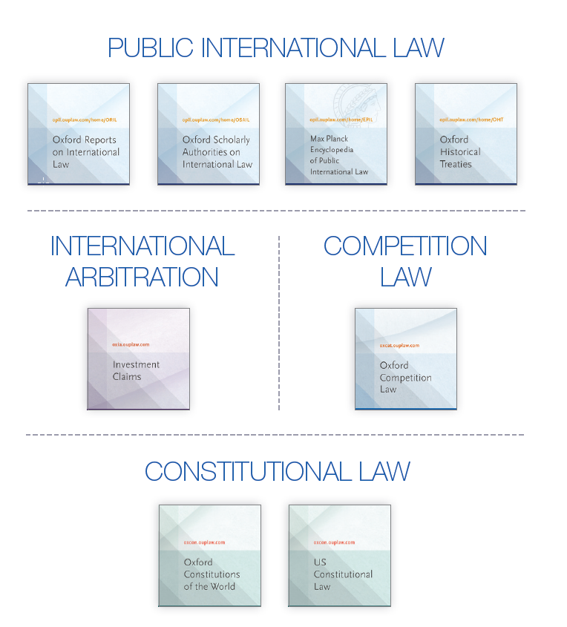
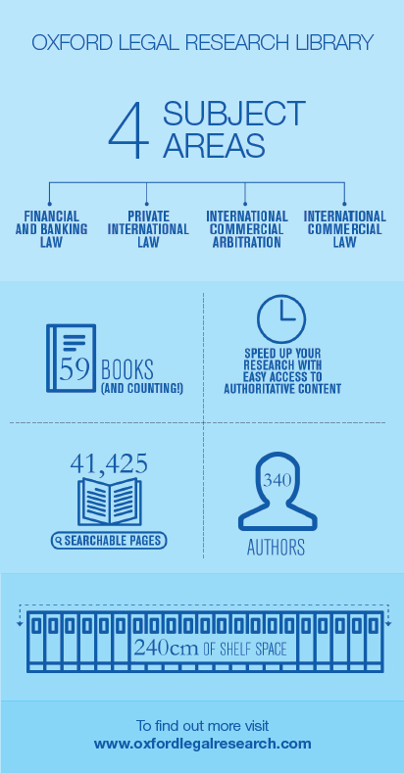
Support to Practitioners in their Fields
OUP in Law
Notes:
We have resources which cover different legal fields including: international commercial law, financial law, private international law, international commercial arbitration in the Oxford Legal Research Library.
You will find in the content – journals, cases, instruments, monographs, analysis, etc.

Slide 30
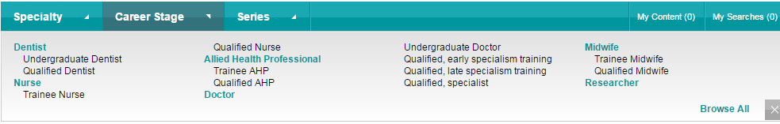




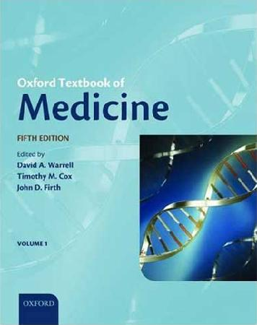



Support to Researchers and Students in their Fields
OUP in Medicine
Notes:
85 specialties and sub-specialties

Slide 31

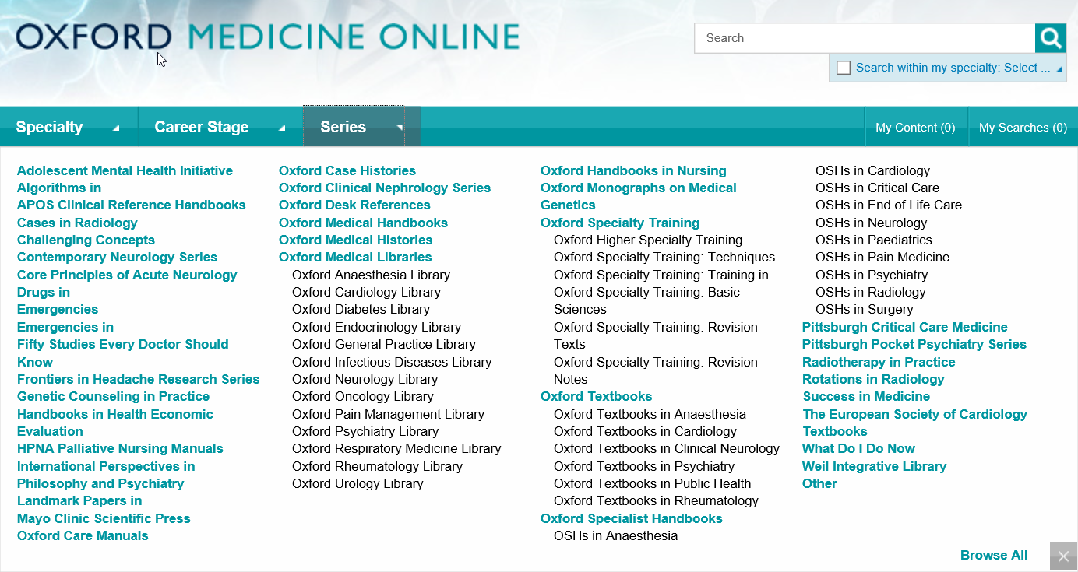
Oxford Medicine Online

Slide 32
Each resource provides a vital step on the research journey, from quick fact checking, to reviewing the literature in a field, to keeping up to date with the latest research.
Where do OUP Resources Fit in your Research Journey?
Subject Specific Resources
Notes:
The following slides show how each resource fits into the research journey. Each resource provides a vital step on the research journey, from quick fact checking, to reviewing the literature in a field, to keeping up to date with the latest research.

Slide 33
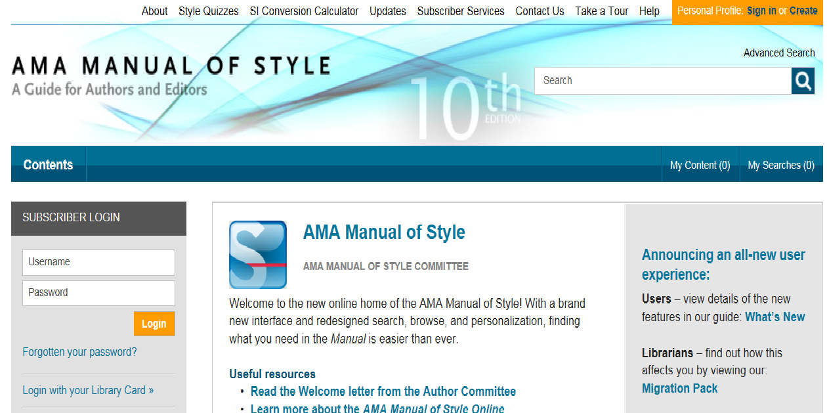
M
AMA Manual of Style

Slide 34
How to get published with international journals?

Slide 35

Before you start………….
You must have a clear topic
or topics to be reviewed,
what is your research
question?

Slide 36
Ideas where to start
As well as ‘traditional’ research…
Are you working on a Doctoral or Master’s thesis?
Have you completed a project which concluded successfully?
Are you wrestling with a problem with no clear solution?
Do you have an opinion or observation on a subject?
Have you given a presentation or conference paper?
If so, you have the basis for a publishable paper

Slide 37

Editors are looking for “something new and preferably surprising” according to Dr. Peter Smith, a Cambridge philosopher and former editor of Analysis, the philosophical journal.
NEW IDEAS
NEW IDEAS
NEW IDEAS

Slide 38
Be Careful:
There are 1,000,000’s of published studies. You need to MASTER your topic: be aware of works completed by others, updates or/and be ready to answer questions or summarize it.

Slide 39
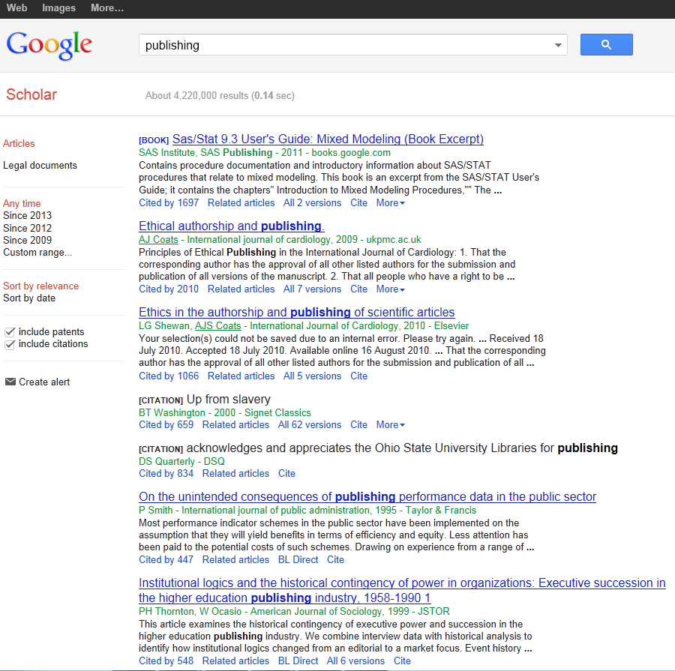
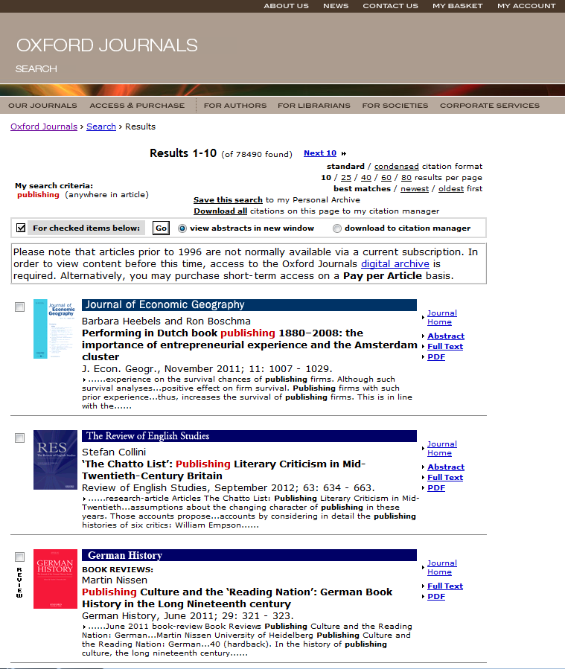
References:

Slide 40
Oxford Bibliographies Online
OBO is a library of discipline-focused, online guides to the essential literature across a broad range of subject areas.
Each OBO article, written and reviewed by top scholars in the field, is rich with citations and annotations, expert recommendations, and narrative pathways through the most useful and important works on the topic in question.
Intuitive linking throughout quickly delivers the user from a citation to full-text content, whether online or available through a library’s catalog.
“We are drowning in information, while starving for wisdom. The world henceforth will be run by synthesizers, people able to put together the right information at the right time, think critically about it, and make important choices wisely.”
— E.O. WILSON
Notes:
Quote from Edward Osborne Wilson Harvard University professor and 2 time winner of the Pulitzer prize.
27 subject areas available; launching 10-12 new subjects each year
Every subject area has an Editor-in-Chief and Editorial Board, and each article receives multiple peer reviews and board vetting
50-100 articles at launch per subject (equivalent to a 4-volume print encyclopedia)
Updated regularly, with 50-75 articles added per year to each subject area. Updates will also include revisions to existing articles.
It is selective, rather than exhaustive; expert recommendations with critical supportive text and annotation are provided to help cut down on time needed for preliminary research
Articles contain recommendations for scholarship at all levels, from encyclopedias and textbooks to journal articles and data sets – whether you’re starting a research paper, studying for qualifying exams, or preparing a syllabus, OBO is the perfect starting place
Includes indexing of non-print material, especially online resources

Slide 41
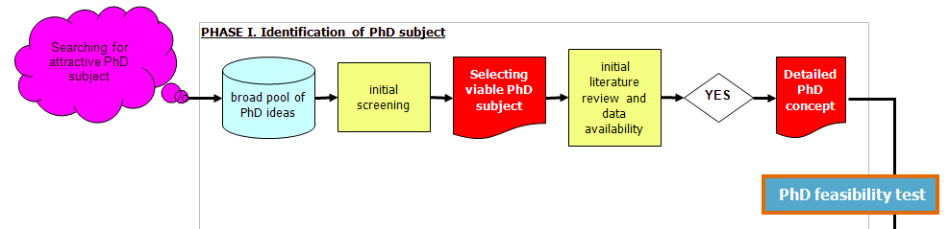
Our Focus

Slide 42
Initial literature review: The 5 X 5 principle
Identify 5 top peer refereed academic journals focusing on
your specific subject
Identify 5 top internationally recognized books or collective
works on your specific subject
Identify 5 top academic research centres specializing in
your subject
Identify 5 most renowned professors in your narrow field
(„gurus”)
Identify 5 top regular international academic conferences
covering your subject

Slide 43

Think of a literature review as a jigsaw puzzle

Slide 44
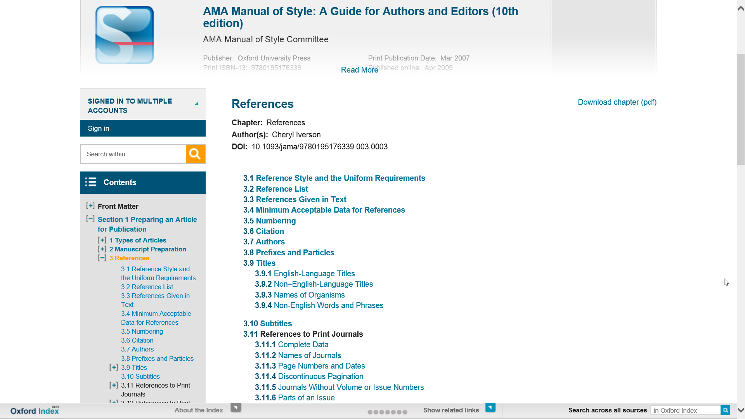

Slide 45
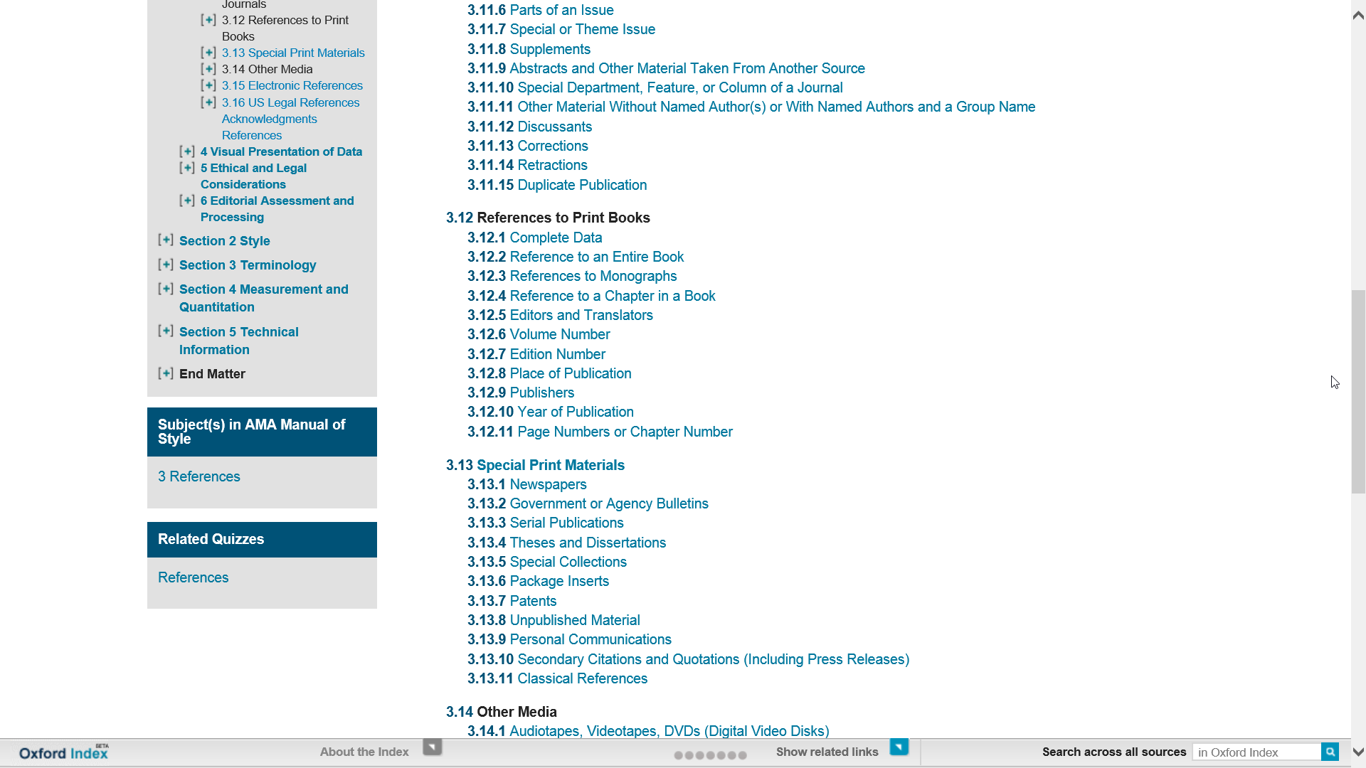

Slide 46
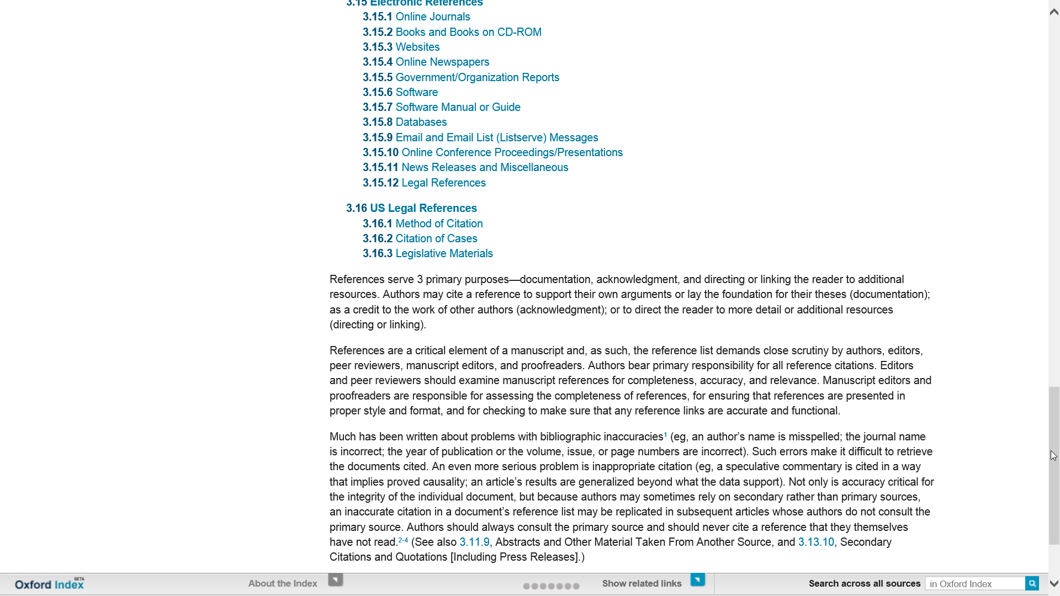

Slide 47

Which journal to go for?

Slide 48
Criteria You Might Look At:
Rankings (example Thomson Reuters Impact factors; the Association of Business Schools ABS etc.)
Number of downloads (utility)
Dissemination of journal (where it is read)
Links to societies/associations
Relevance of content and publishing ethos
International

Slide 49
Questions to Ask Yourself
When Choosing:
What are your most important factors when choosing a journal?
Which resources do you use to research the journals you publish in?
Which rankings do you use? How important are they?
Who do you ask for advice?
What is the best journal in your field? Why?

Slide 50

PROCESS!!!!!
Putting A and B together to build up your work

Slide 51
Surviving peer review
Not always straight forward proccess

Slide 52
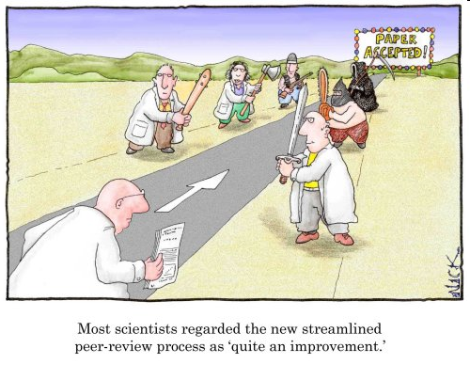
Research is all about peer review
You need to avoid a desk reject
You may need to revise and resubmit
You will almost certainly need to alter your paper

Slide 53
The Process
Submission is an important step on the road to being published
Reviewers are selected for their expertise by the Editors
They do sometimes make mistakes and their opinions may not be valid
But generally they raise genuine concerns about the work – conceptualization, execution and/or interpretation of the work

Slide 54
The Process
Their comments are aimed at maintaining the quality of papers publish in the journal, the overall journal reputation and ultimately at improving your work to attain a high standard of academic writing.

Slide 55
Process Conclusion:
Identify a few possible target journals but be realistic
Follow the Author Guidelines: scope, type of paper, word length, references style, etc.
Find where to send your paper (editor, regional editor, subject area editor) …
… and how to send it (email, hard copy, online submission)
Send an outline or abstract to editor: is it suitable? how can it be made so?
Read at least one issue of the journal

Slide 56
www.oxfordjournals.org

Slide 57
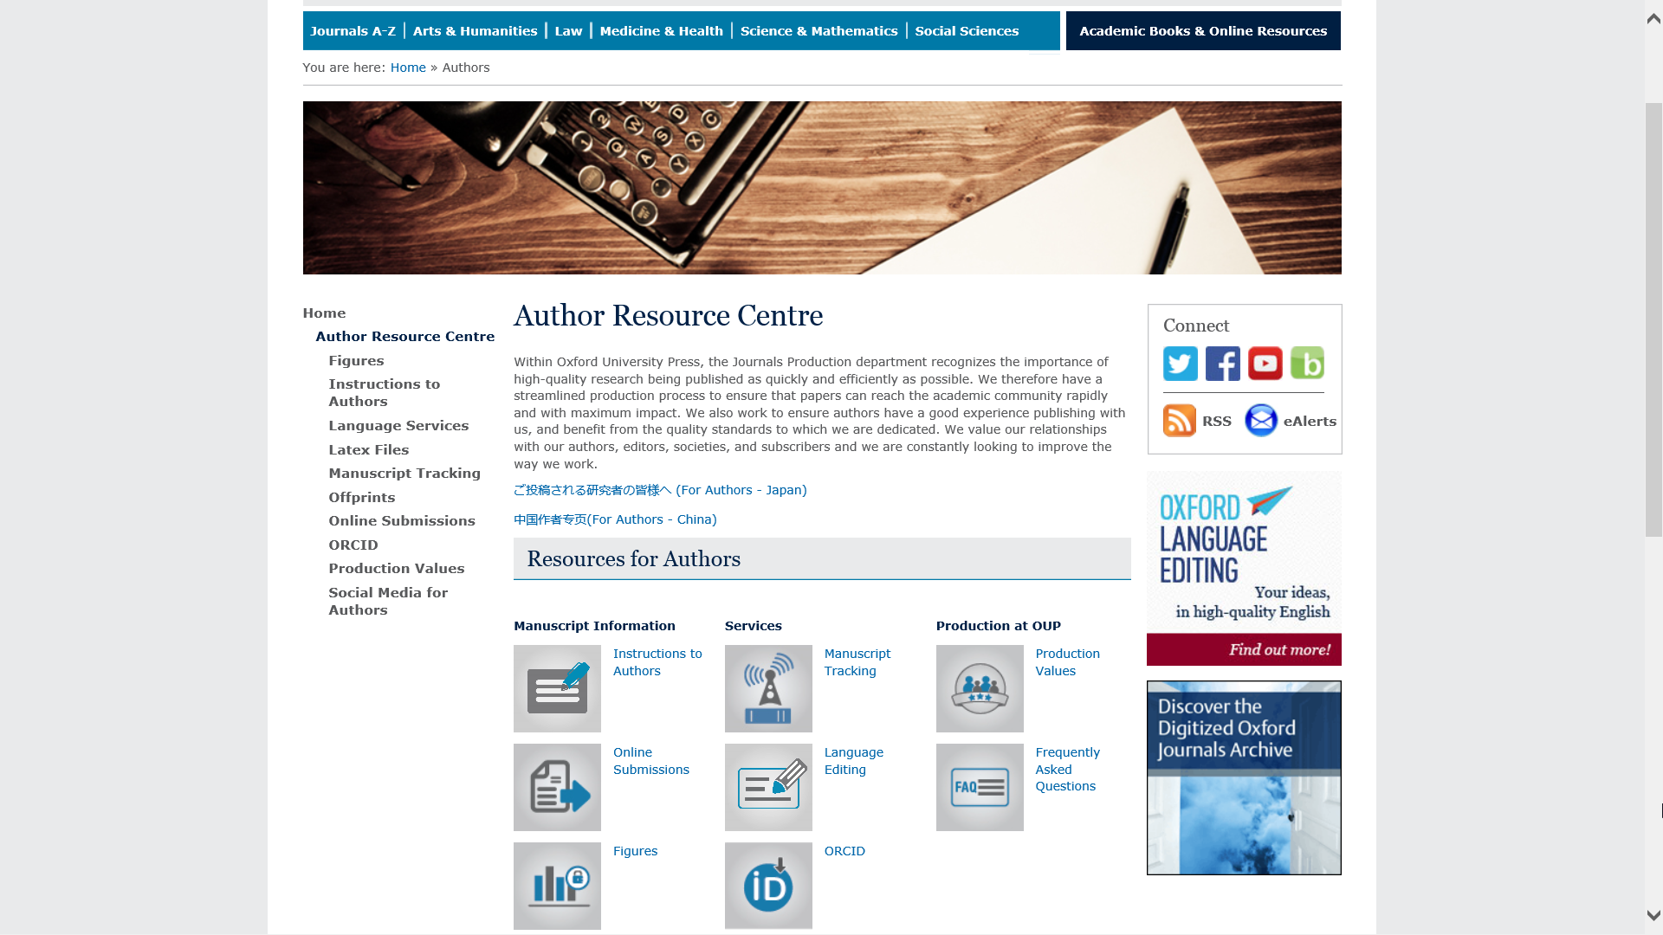

Slide 58
www.oxfordjournals.org

Slide 59
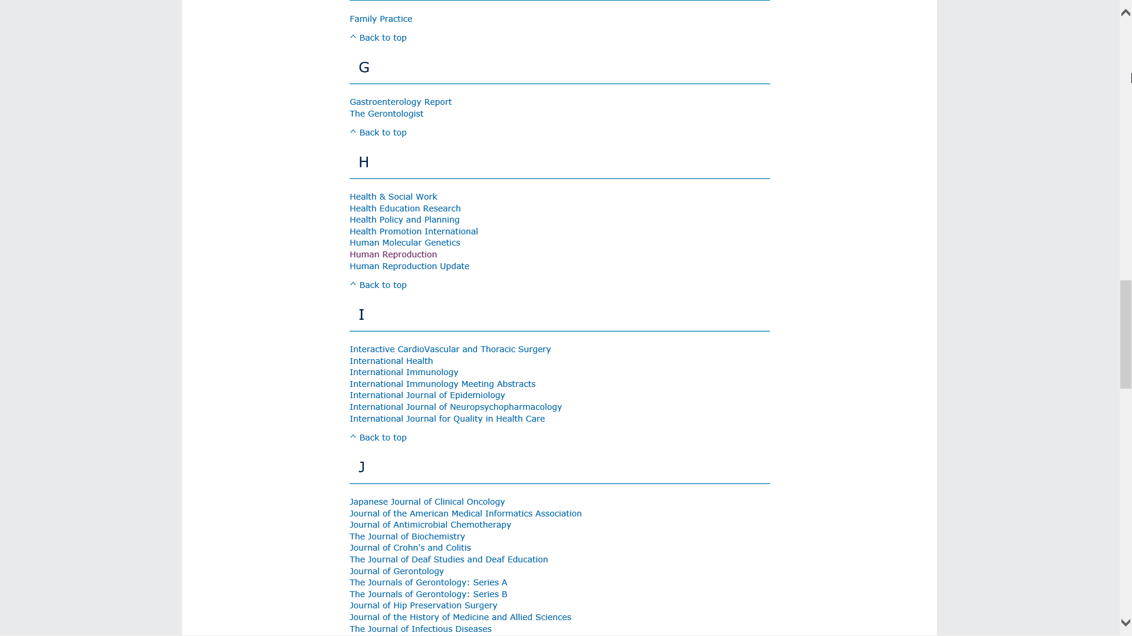

Slide 60
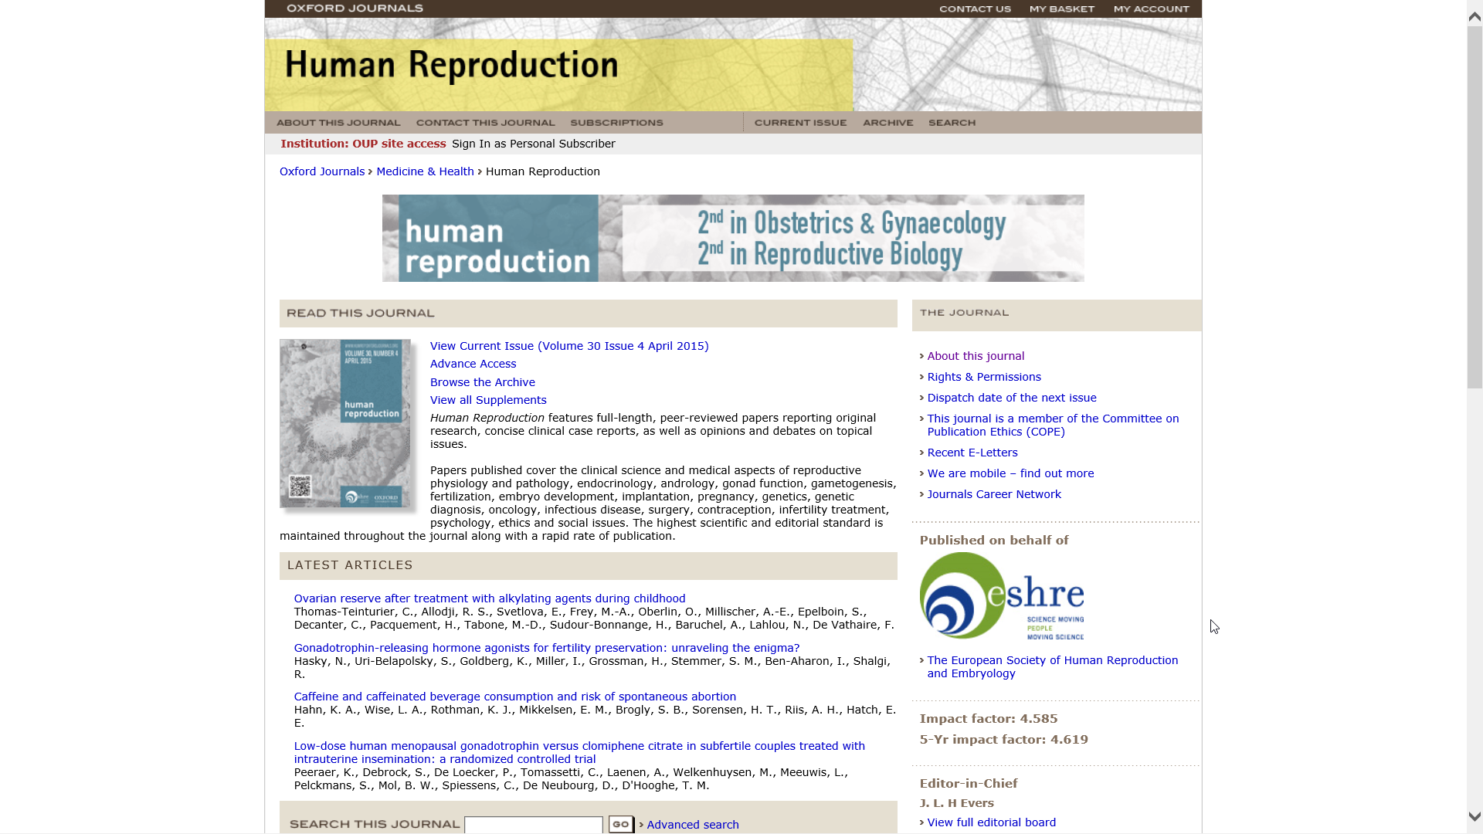

Slide 61
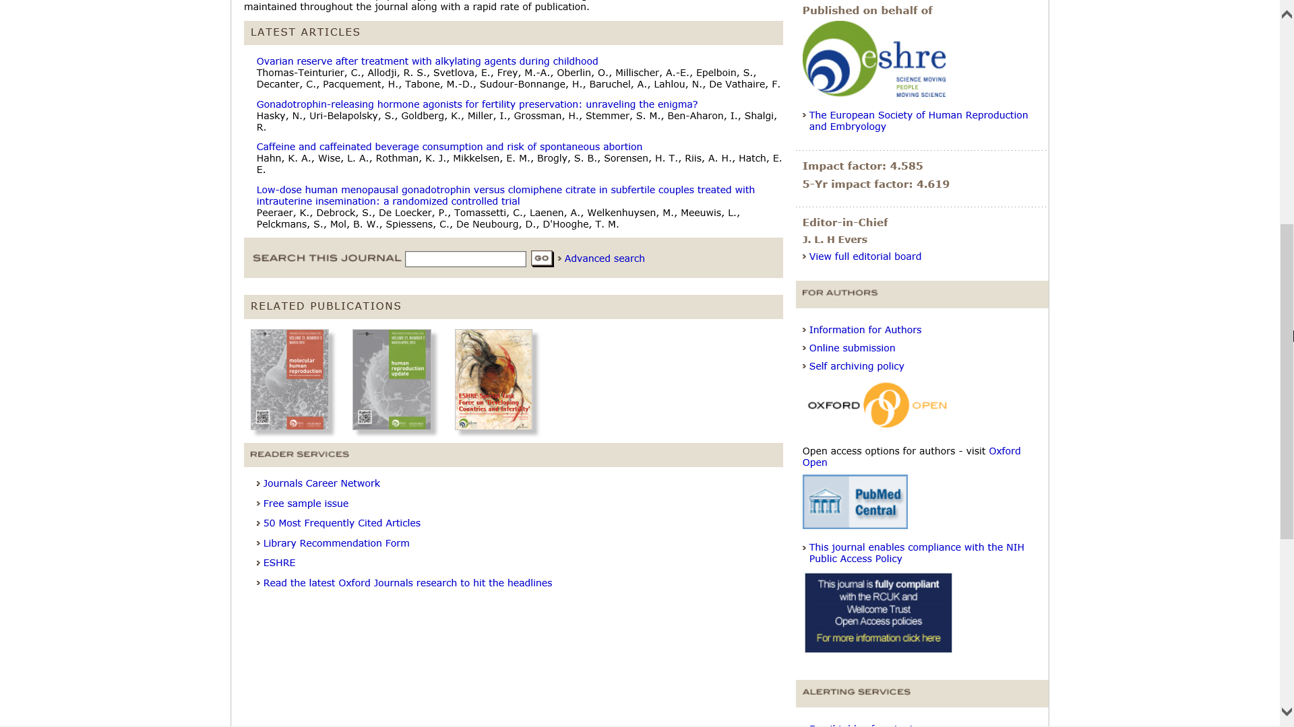

Slide 62
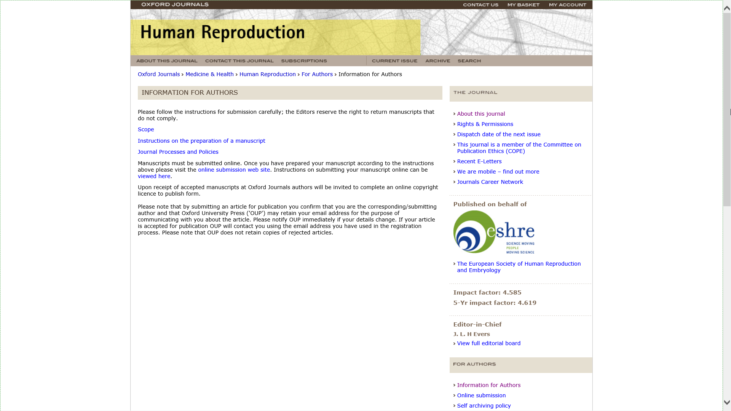

Slide 63
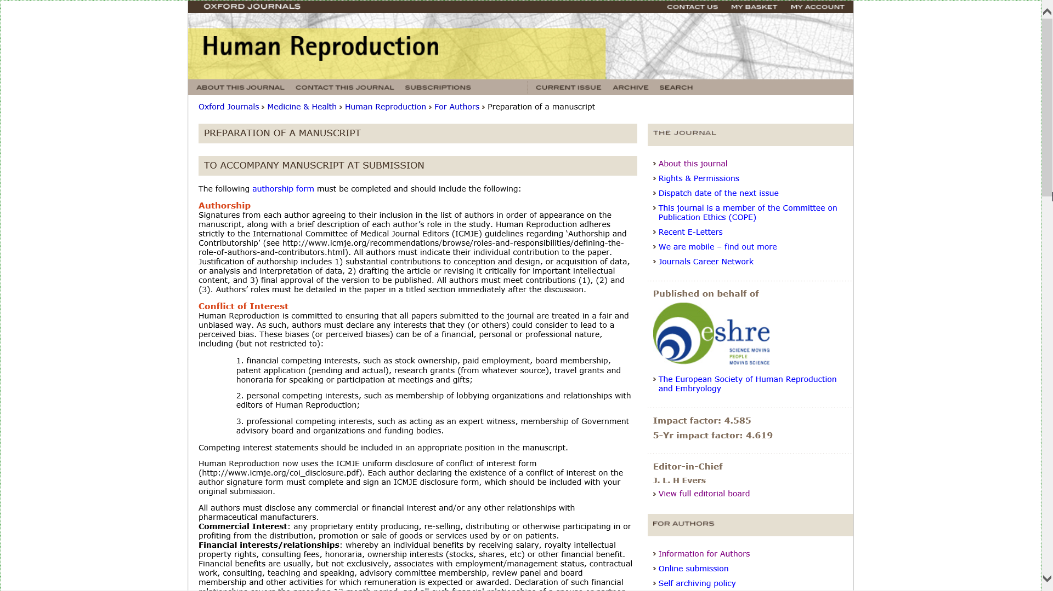

Slide 64
What makes a good paper?
HINT: Editors and reviewers look for …
Originality – what’s new about subject, treatment or results?
Relevance to and extension of existing knowledge
Research methodology – are conclusions valid and objective?
Clarity, structure and quality of writing – does it communicate well?
Sound, logical progression of argument
So what?’ factors!
Recency and relevance of references
Adherence to the editorial scope and objectives of the journal
A good title, keywords and a well written abstract

Slide 65
Co-authorship?
With supervisor, different departments or institutions
Exploits individual strengths
Especially useful for cross-disciplinary research
Demonstrates the authority and rigour of the research
Increases potential pool of citations
But remember
Ensure paper is edited so that it reads as one voice
Identify the person responsible for closing the project
Agree and clarify order of appearance of authors

Slide 66
Peer Review:
Peer Review is important to assess your work before submitting it.
Have fellow colleagues, tutors, scholars look at your work and give you feedback to avoid desk rejection. You do not want to be refused by appearing uninformed concerning your submission.
Always expect that you would have to amend, alter and revise your paper to submit a more accurate version.

Slide 67
Plagiarism and referencing
Plagiarism (from the Latin plagium meaning ‘a kidnapping’) is the act of taking someone else’s work and pretending it is yours. It is considered fraud!
It isn’t always detected in peer review but electronic tools can help

Slide 68
Revising
A request for revision is good news!
  You’ve avoided a desk reject and you are in the publishing cycle
  Nearly every published paper is revised at least once
  So now, close the deal!
Acknowledge the editor and set a revision deadline
Clarify if in doubt – ‘This is what I understand your comments to mean…’
Meet the revision deadline
Attach a covering letter showing how you met the reviewers’ requests (or if not, why not)

Slide 69
Dealing with the comments:
Answer as completely as possible
Answer politely, be tactful and not with emotive language
Answer with evidence
If you feel the reviewer has misunderstood then address the point with a good argument explaining why the reviewer is mistaken
  It may be the reviewers are conflicted on a point
  It is ok to use one reviewer to argue against another

Slide 70
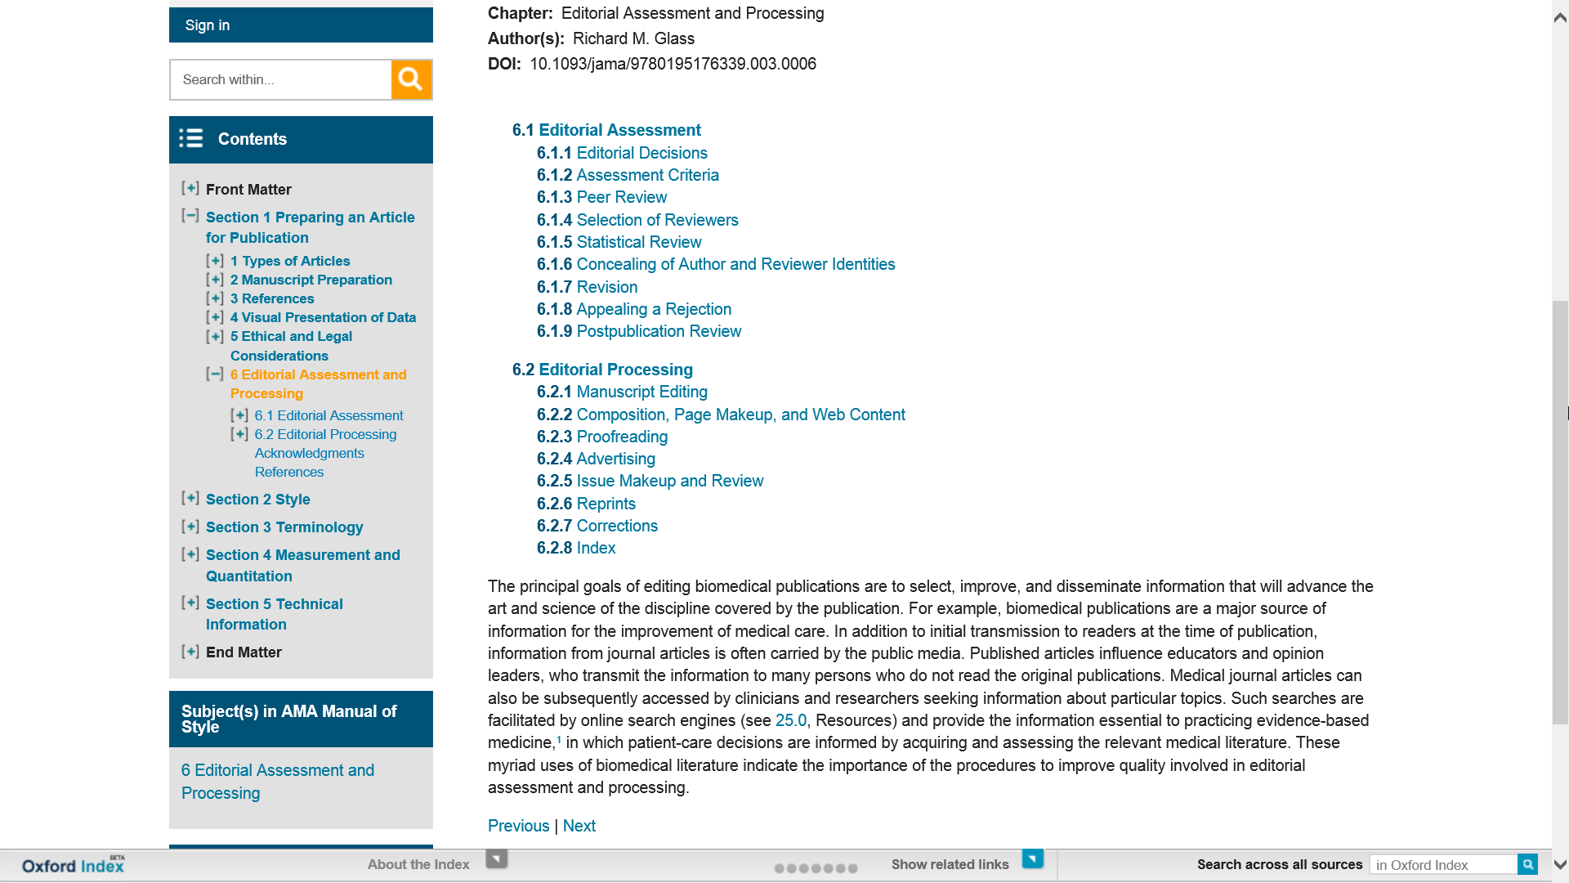

Slide 71

In case of rejection:

Slide 72


Slide 73
If your article is rejected
Ask why, and listen carefully!
Most editors will give detailed comments about a rejected paper. Take a deep breath, and listen to what is being said
Try again!
Try to improve the paper, and re-submit elsewhere. Do your homework and target your paper as closely as possible
Don’t give up!
At least 50% of papers don’t get published. Everybody has been rejected at least once
Keep trying!

Slide 74
How to sell your work
Use a short descriptive title containing main keyword – don’t mislead
Write a clear and descriptive abstract containing the main keywords and following any instructions as to content and length
Provide relevant and known keywords – not obscure new jargon
Make your references complete and correct – vital for reference linking and citation indices
All of this will make your paper more discoverable which means more dissemination and possibly more citation

Slide 75
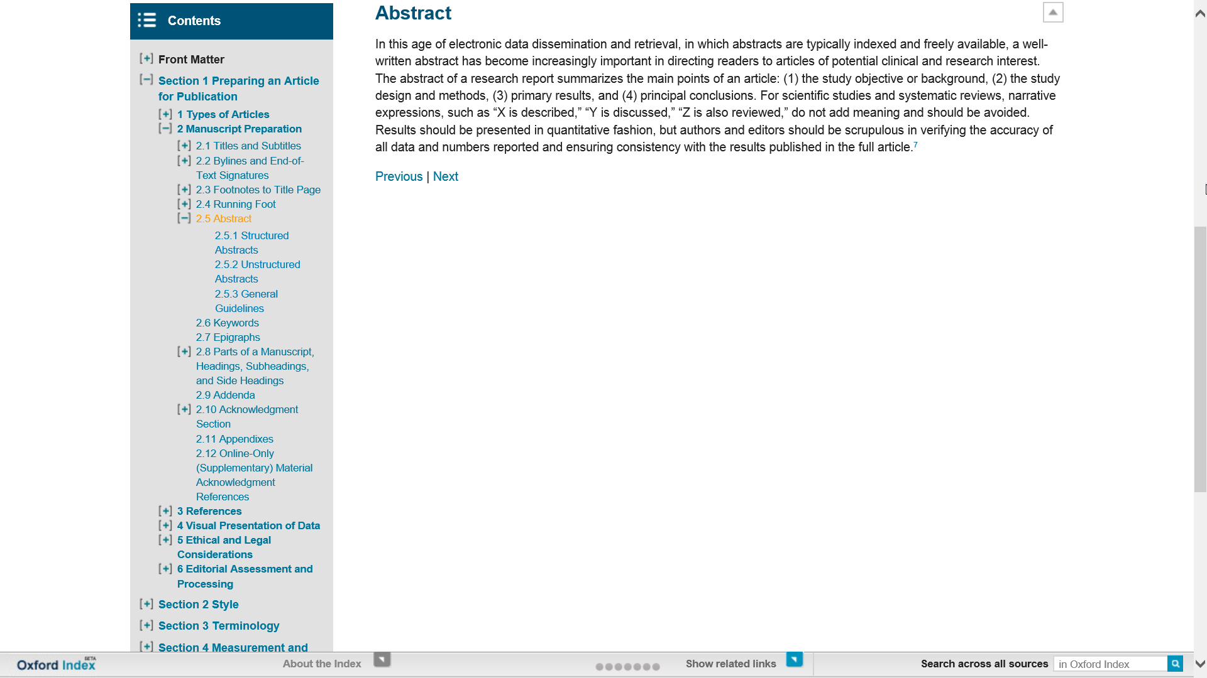

Slide 76
YOU DID IT!!!!!!!

Slide 77

Any Questions…
Marcin Dembowski
marcin.dembowski@oup.com

